Slide 1

CIS: Empowering Future Tech Leaders for Career Success
-- Exclusively Designed for Computer Information System Students --
DEC 2023

Slide 2
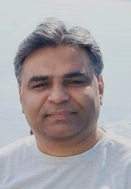
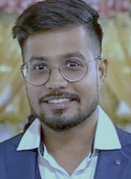

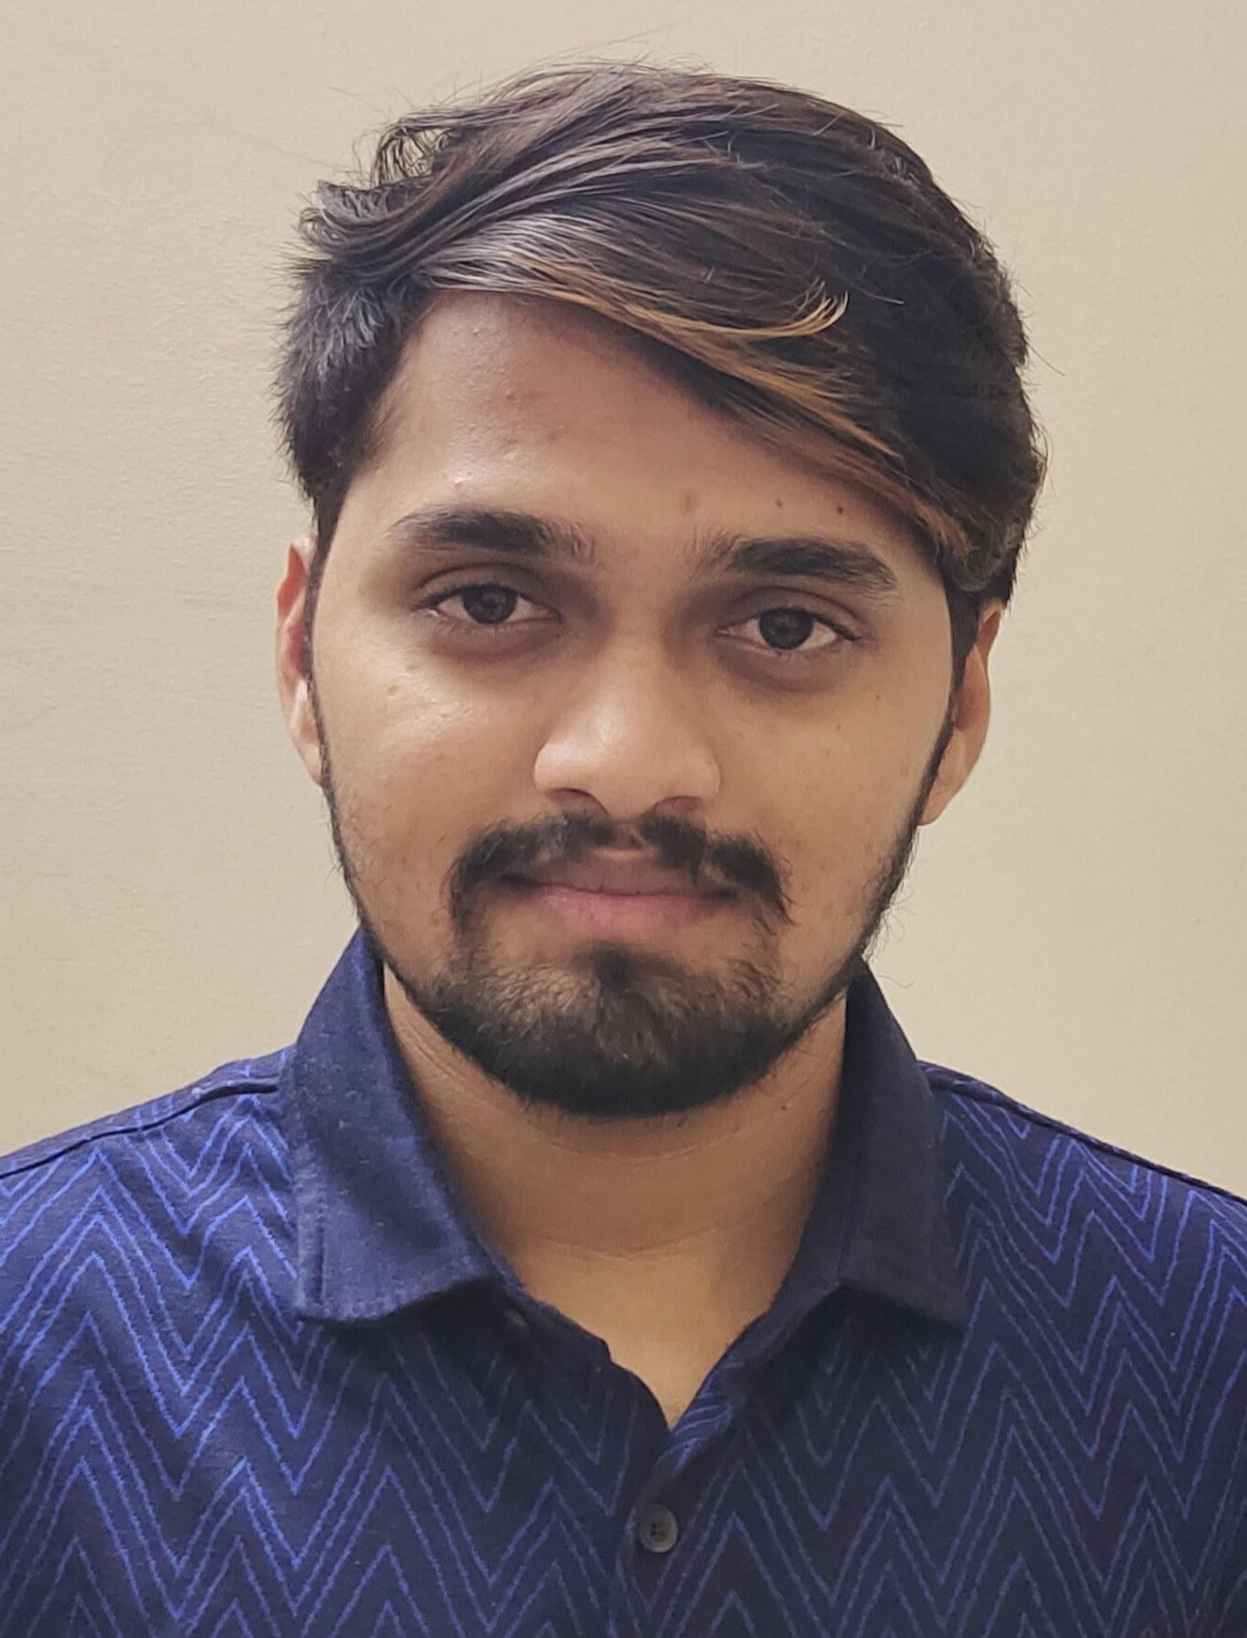
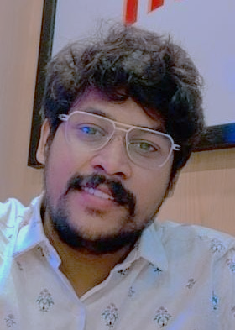
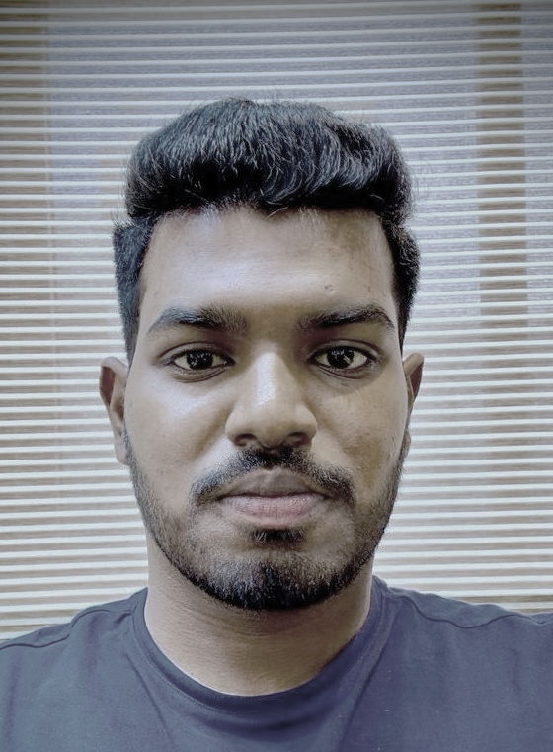


meet our team…
SAPAN SHAH
SNEHIL SARKAR
XAVIER COLIN
D’MAC Design Maniac
ADITYARAM NATAKARANI
SAI SRIDHAR KARRI
KAUSHIK NAIDU ADHIKARI

Slide 3
Design Journey
EMPATHIZE
DEFINE
IDEATE
PROTOTYPE
TEST
METHODOLOGY

Slide 4
DEFINE problems…
Picking up the right events, conferences or hackathons.
Accessing available resources within campus.
Approaching faculties or other authorities to discuss their issues.
Impact of their earned degrees in actual job market.
Figuring out job availabilities and skills required to fulfill requirements.
Build up profile and networks to grab right job.
Shining up core and soft skills.
Internship to experience real time job environment.
Contacts of alumni for additional guidance.

Slide 5
Quadrants (In general)…
SAY
Classes are need to be more interactive.
Invest in modern infrastructure and advanced resources.
Arrange Internship opportunities.
Tie-up with IT companies.
THINK
Take action to control retention rate.
Set up evening classes only so professional people can well manage their time.
Free and easily accessible in-campus medical facilities.
Better public transport facility for students
DO
Provide resources to shine up soft skills.
Guide students to make them employable in future.
More elective courses are offered.
Promote cultural events of different ethnicity.
FEEL
Encourage successful alumni to share their experiences.
Bring more IT-related guest lecturers.
Career fairs should be more effective.
Research based project and activities to be introduced.

Slide 6
SURVEY
based on…
CSULA Marketing/ Promotion, Rewards for Events, Affordability, Internship, Career fairs, Overshadowed by other CSUs, Core/ Soft skills, Guest lecturers, Health activities, Quiz competitions & Scholarships.

Slide 7
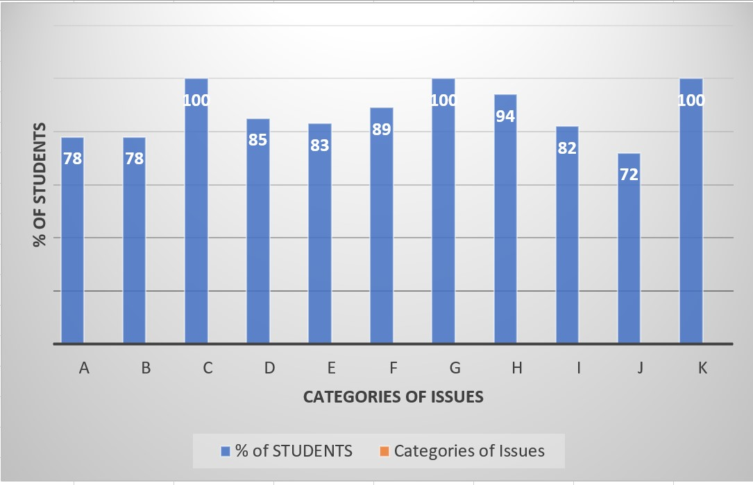
SURVEY conclusion…
A – More Marketing / Promoting CSULA
B – Rewards to take part in Events
C – Affordability- A key factor
D – Overshadowed by other CSUs
E – Internship –a part of Curriculum
F – Inviting IT Guest lecturers
G – Effective career fairs
H – Shining up core/ soft skills
I – More Health-related activities
J – Inter college Quiz competition
K – More Scholarships offer

Slide 8
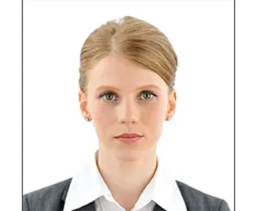
PERSONAS
Name: Sarah Lopez
Age: 24
Born: Los Angeles USA
Student: 1st sem. MSIS at CSULA
Sarah, a talented girl is pursuing masters in Information System at California State University, Los Angeles. She has been living with her parents and siblings in LA City since her birth. She has always been looking for school and college closer to her home so she can manage her studies while staying with her parents’ home. Her career goal is to get a job in one of the well-known IT companies as a Data Scientist.
Her main reason to choose CSULA was not just only ease in commutation but also well affordable as CSULA receives significant amount of funds every year which makes local students to pay less tuition fees. She has also considered the popularity of this University as one of the factors while making decision.
She wishes that her profile receives good responses in a job market after finishing her study at CSULA and to get appreciation for skills and knowledge gained in this University.
She suggests that CSULA should put more efforts to attract talented students not only from US but all over the world and reach out the companies who get ready to send their talented employees as part time students to upskill themselves.
Some Inter-school quiz competitions are need to be arranged specifically for IS/IT students so they could face real time competitive atmosphere and realize where they stand. IT people mostly remain in stressful situations throughout their career so stress busting activities like yoga, meditation are also to be introduced.

Slide 9
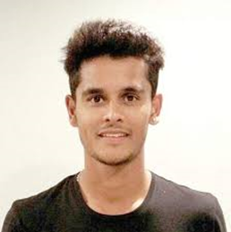
PERSONAS
Name: Rahul Singh
Age: 23
Born: Mumbai INDIA
Student: 3rd sem. MSIS at CSULA
Rahul, Indian national has completed his under graduation from Mumbai University in Computer Science and is now pursuing masters at CSULA in Information Systems. While choosing this university, he was not aware of the different CSUs campuses and their significance. He only considered the state and location popularity.
He believes that CSULA has to send their representatives to the many locations especially in India and China to make the students aware with CSULA, on spot admission and offering scholarships to talented students. As international students are used to pay more tuition fees compare to local students so fees should be competitive and reasonable.
In this University, He likes to be a part of diversified culture and the same he desires to have in professional career in US after finishing his study, so he wants mandatory internship to be introduced as a part of curriculum to get real time professional experience and enhance his chances for employment. Guest lecturers from the IT companies are also to be invited frequently to motivate, guide and aware with current & future job trends.
As the International students mostly rely on buses and shuttles so public transport system should be more robust and efficient so they can save their valuable time considerably.

Slide 10
PROTOTYPE
APPLICATION
- Made by Computer Information Systems Student Club (CISSC)

Slide 11
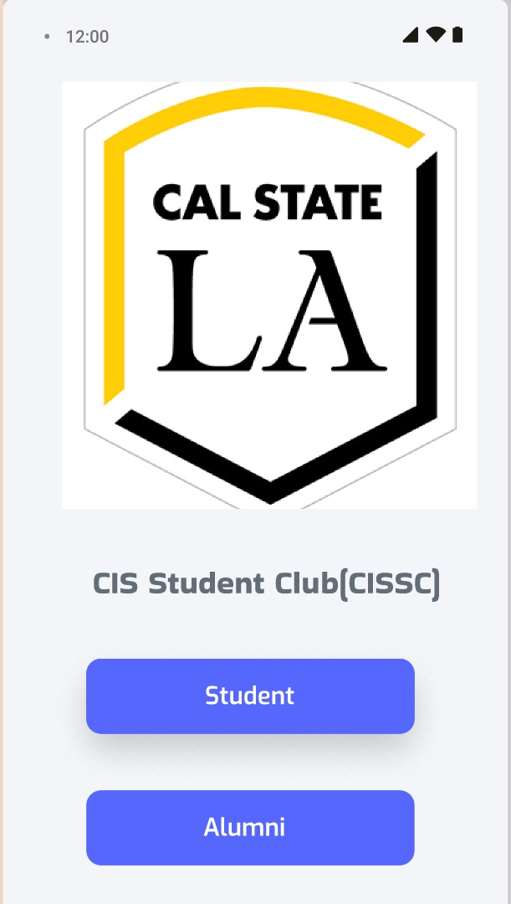
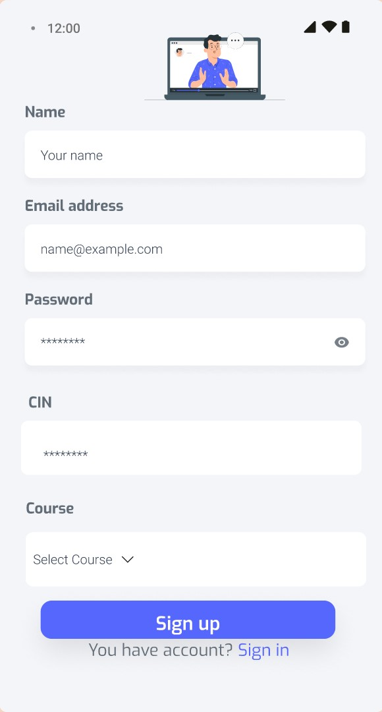
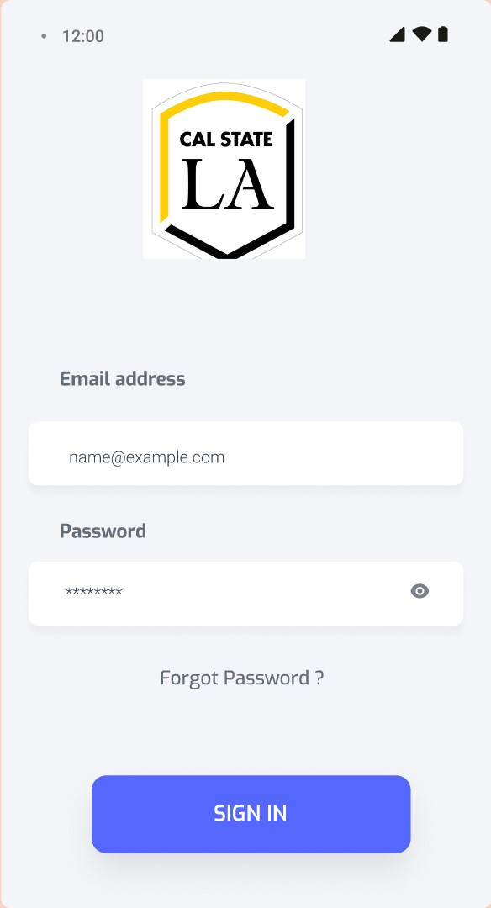

Slide 12
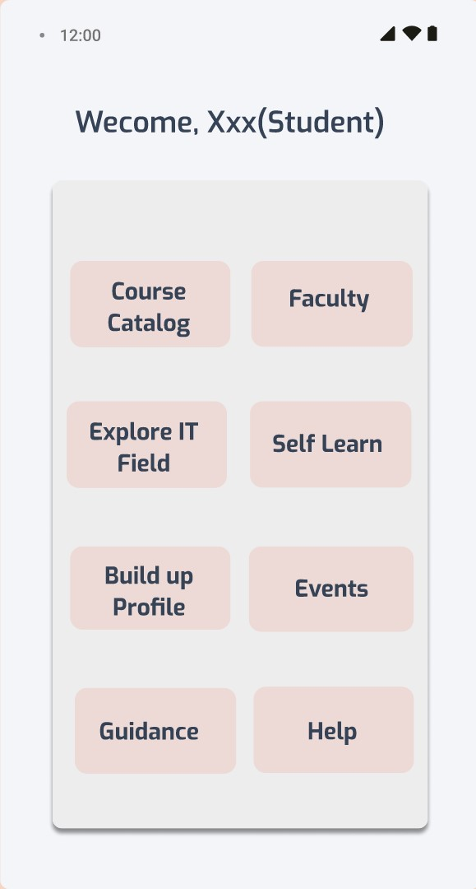
8- IMPORTANT TILES
Students can access this Index of Tiles representing various categories.
Each category has a pool of information and sources that IT students of CSULA can utilize throughout their term time.

Slide 13
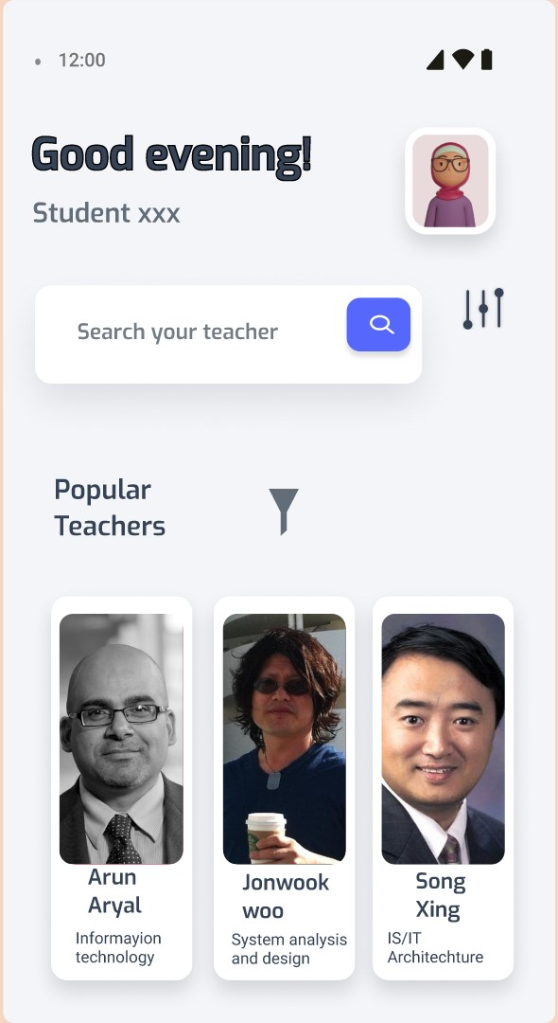
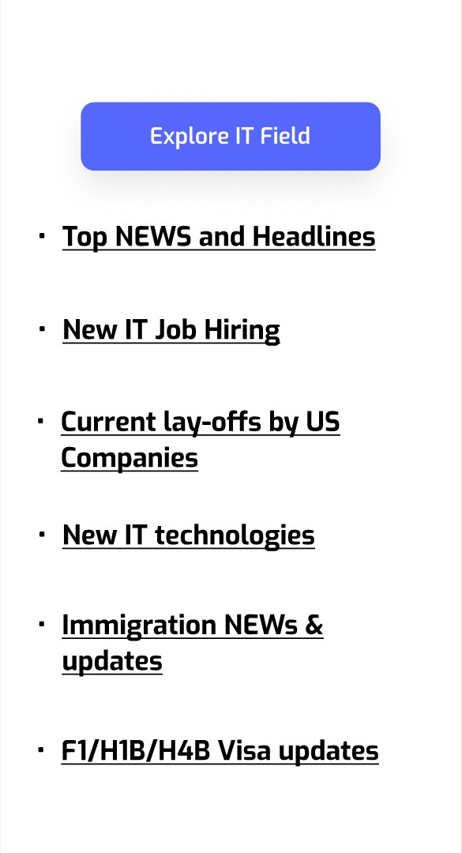
FACULTY Information:
Students have opportunity to know the all IT faculties, their background, experience, expertise and contact details.
IT-related & Immigration (Intl. students) CURRENT AFFAIRS:
Sources:
Techcrunch.com
Thenextweb.com
Wired.com
Wsj.com/tech
Layoffs.fyi
USCIS.gov

Slide 14
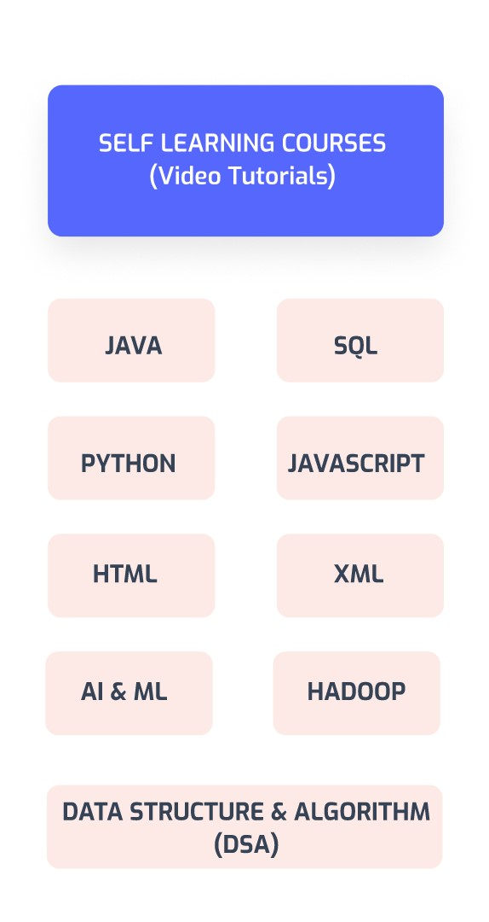
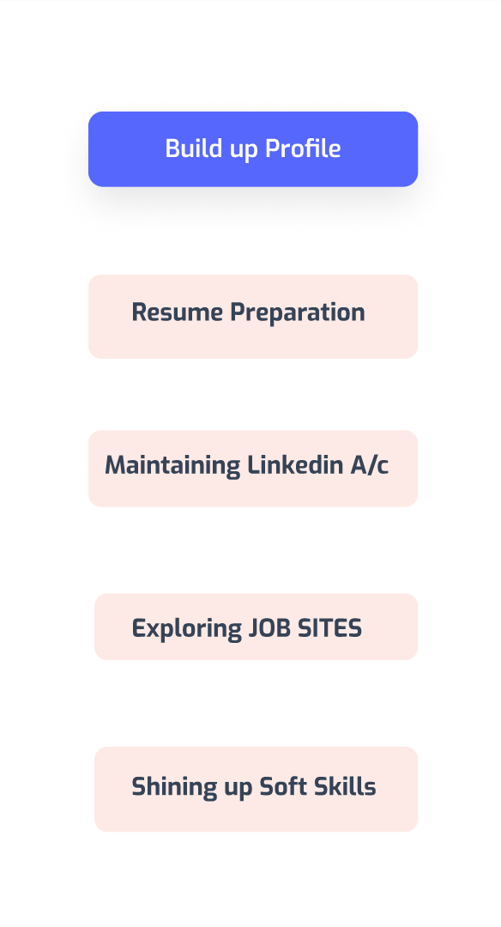
VIDEO TUTORIALS:
Sources-
Youtube videos
Udemy.com
W3schools.com
Learning.linkedin.com
JOBSITES & Building UP Profile:
Indeed.com
Linkedin Jobs
Stackoverflow.com
Hired.com
&
- Other Guided material and tips provided for Resume preparation, maintaining Linkedin profile.

Slide 15
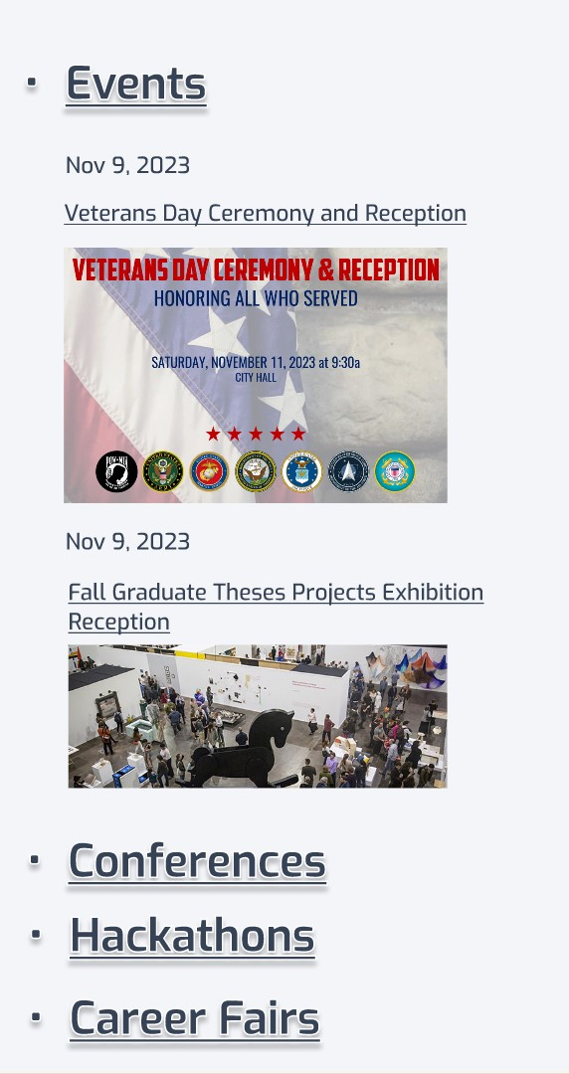
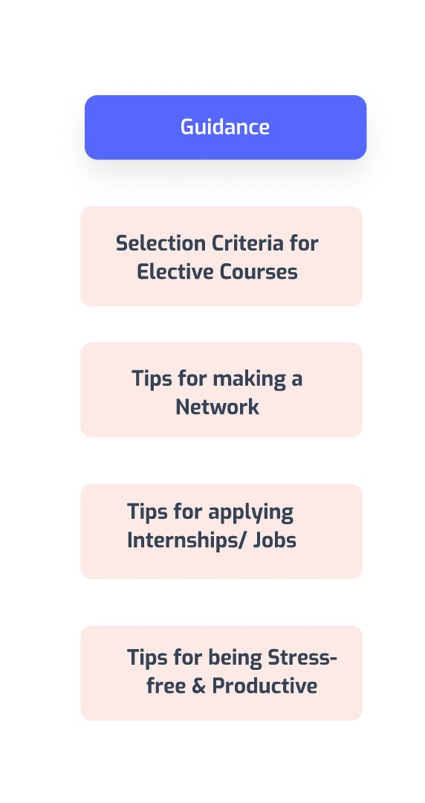
GUIDANCE:
Tips and guided notes are provided for course selection, making network, jobs & internships and other health activities.
EVENTS/ CONFERENCES/ FAIRS:
Specific IT related fairs & events information shortlisted.
Sources:
CSULA portal
www.clocate.com
www.10times.com
www.eventbrite.com
www.hackdavis.io

Slide 16
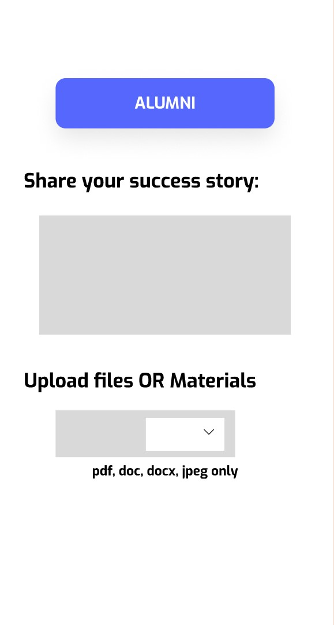
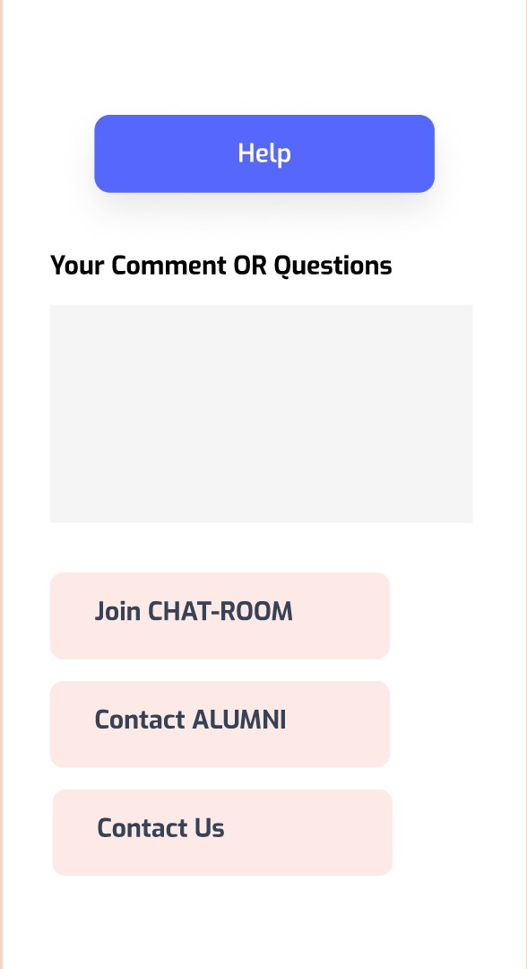
ALUMNI:
Provide guidance and right path to achieve success.
Can share their thoughts and materials to the existing students.
HELP:
Students can raise their issues and queries by writing brief notes.
Also use chat room to get in touch with others.
Contact alumni or us through provided details.

Slide 17

summary
By this application, we believe in giving 100% assistance to the CIS students in every possible aspects so we all can excel in our career and make CSULA and all faculties proud. We as a team are set to push our boundaries and truly believe “ Success is not an overnight achievement; it is the result of consistent efforts fueled by the right approach.”

